Slide 1

Course: Distributed and Cloud Computing
Chapter 6: Cloud Security

Slide 2
Contents
Cloud security risks
Privacy; privacy impact assessment, Trust
Security of virtualization.
Security risks posed by shared images
Security risks posed by a management OS
Xoar - breaking the monolithic design of the TCB
A trusted virtual machine monitor
School of Computer Science and Engineering

Slide 3
Computer security in the new millennium
In an interconnected world, various embodiments of malware can migrate easily from one system to another, cross national borders and infect systems all over the globe.
The security of computing and communication systems takes a new urgency as the society becomes increasingly more dependent on the information infrastructure.
Even the critical infrastructure of a nation can be attacked by exploiting flaws in computer security.
Term cyberwarfare has entered the dictionary meaning “actions by a nation-state to penetrate another nation's computers or networks for the purposes of causing damage or disruption”
School of Computer Science and Engineering

Slide 4
Cloud security
A computer cloud is a target-rich environment for malicious individuals and criminal organizations.
Major concern for existing users and for potential new users of cloud computing services. Outsourcing computing to a cloud generates new security and privacy concerns.
Standards, regulations, and laws governing the activities of organizations supporting cloud computing have yet to be adopted.
Many issues related to privacy, security, and trust in cloud computing are far from being settled.
There is the need for international regulations adopted by the countries where data centers of cloud computing providers are located.
Service Level Agreements (SLAs) do not provide adequate legal protection for cloud computer users, often left to deal with events beyond their control.
School of Computer Science and Engineering

Slide 5
Cloud security risks
Traditional threats: impact amplified due to the vast amount of cloud resources and the large user population that can be affected.
New threats: cloud servers host multiple VMs; multiple applications may run under each VM. Multi-tenancy and VMM vulnerabilities open new attack channels for malicious users.
Identifying the path followed by an attacker more difficult in a cloud environment.
Authentication and authorization: the procedures in place for one individual does not extend to an enterprise.
Third-party control: generates a spectrum of concerns caused by the lack of transparency and limited user control.
Availability of cloud services: system failures, power outages, and other catastrophic events could shutdown services for extended periods of time.
School of Computer Science and Engineering

Slide 6
Attacks in a cloud computing environment
Three actors involved; six types of attacks possible.
The user can be attacked by:
Service: SSL certificate spoofing, attacks on browser caches, or phishing attacks.
The cloud infrastructure: attacks that either originates at the cloud or spoofs.
The service can be attacked by:
A user: buffer overflow, SQL injection, and privilege escalation types of attacks.
The cloud infrastructure: Limiting access to resources, privilege-related attacks, data distortion, injecting additional operations.
The cloud infrastructure can be attacked by:
A user: targets the cloud control system.
A service: requesting an excessive amount of resources and causing the exhaustion.
School of Computer Science and Engineering

Slide 7
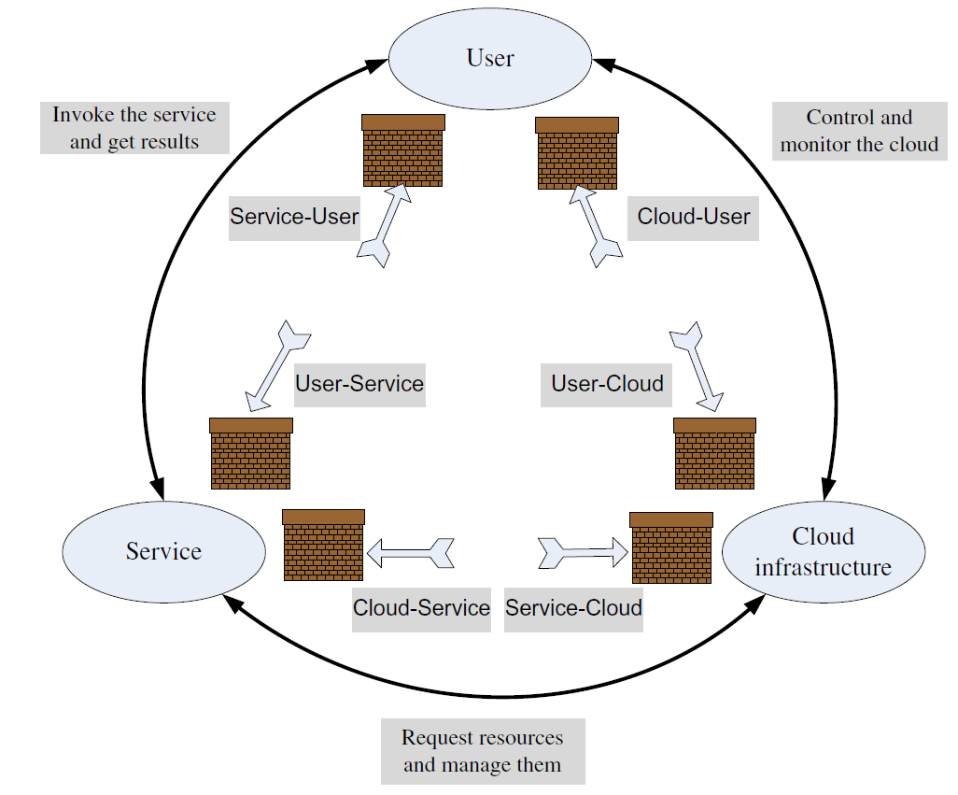
Surfaces of attacks in a cloud computing environment
School of Computer Science and Engineering

Slide 8
Top threats to cloud computing
Identified by a 2010 Cloud Security Alliance (CSA) report:
The abusive use of the cloud - the ability to conduct nefarious activities from the cloud.
APIs that are not fully secure - may not protect the users during a range of activities starting with authentication and access control to monitoring.
Malicious insiders - cloud service providers do not disclose their hiring standards and policies.
Shared technology and Account hijacking.
Data loss or leakage - if the only copy of the data is stored on the cloud, then sensitive data is permanently lost when cloud data replication fails.
Unknown risk profile - exposure to the ignorance or underestimation of the risks of cloud computing.
School of Computer Science and Engineering

Slide 9
Auditability of cloud activities
The lack of transparency makes auditability a very difficult proposition for cloud computing.
Auditing guidelines elaborated by the National Institute of Standards (NIST) are mandatory for US Government agencies:
the Federal Information Processing Standard (FIPS).
the Federal Information Security Management Act (FISMA).
School of Computer Science and Engineering

Slide 10
Privacy
Privacy: the right of an individual, a group of individuals, or an organization to keep information of personal nature or proprietary information from being disclosed.
Privacy is protected by law; sometimes laws limit privacy.
The main aspects of privacy are: the lack of user control, potential unauthorized secondary use, data proliferation, and dynamic provisioning.
Digital age has confronted legislators with significant challenges related to privacy as new threats have emerged.
For example, personal information voluntarily shared, but stolen from sites granted access to it or misused can lead to identity theft.
Privacy concerns are different for the three cloud delivery models and also depend on the actual context.
School of Computer Science and Engineering

Slide 11
Federal Trading Commission Rules
Web sites that collect personal identifying information from or about consumers online required to comply with four fair information practices:
Notice: provide consumers clear and conspicuous notice of their information practices, including what information they collect, how they collect it, how they use it, how they provide Choice, Access, and Security to consumers.
Choice: offer consumers choices as to how their personal identifying information is used both internal secondary uses and external secondary uses.
Access: offer consumers reasonable access to the information a web site has collected about them, including a reasonable opportunity to review information.
Security: take reasonable steps to protect the security of the information they collect from consumers.
School of Computer Science and Engineering

Slide 12
Privacy Impact Assessment (PIA)
The need for tools capable to identify privacy issues in information systems.
The inputs to the tool includes project information, an outline of project documents, privacy risks, and stakeholders.
The tool will produce a PIA report consisting of a summary of findings, a risk summary, security, transparency, and cross-border data flows.
There are no international standards for such a process, though different countries and organization require PIA reports.
The center piece of a proposed PIA tool is based on a SaaS service.
The users of the SaaS service providing access to the PIA tool must fill in a questionnaire.
The system used a knowledge base (KB) created and maintained by domain experts.
The system uses templates to generate additional questions necessary and to fill in the PIA report.
An expert system infers which rules are satisfied by the facts in the database and provided by the users and executes the rule with the highest priority.
School of Computer Science and Engineering

Slide 13
Trust
Trust: assured reliance on the character, ability, strength, or truth of someone or something.
Complex phenomena: enable cooperative behaviour, promote adaptive organizational forms, reduce harmful conflict, decrease transaction costs, promote effective responses to crisis.
Two conditions must exist for trust to develop.
Risk: the perceived probability of loss; trust not necessary if there is no risk involved, if there is a certainty that an action can succeed.
Interdependence: interests of one entity cannot be archived without reliance on other.
School of Computer Science and Engineering

Slide 14
Trust
A trust relationship goes though three phases:
Building phase, when trust is formed.
Stability phase, when trust exists.
Dissolution phase, when trust declines.
An entity must work very hard to build trust, but may lose the trust very easily.
School of Computer Science and Engineering

Slide 15
Internet trust
Obscures or lacks entirely the dimensions of character and personality, nature of relationship, and institutional character of the traditional trust.
Offers individuals the ability to obscure or conceal their identity. The anonymity reduces the cues normally used in judgments of trust.
Identity is critical for developing trust relations, it allows us to base our trust on the past history of interactions with an entity.
Anonymity causes mistrust because identity is associated with accountability and in absence of identity accountability cannot be enforced.
The opacity extends identity to personal characteristics.
It is impossible to infer if the entity or individual we transact with is who it pretends to be, as the transactions occur between entities separated in time and distance.
There are no guarantees that the entities we transact with fully understand the role they have assumed.
School of Computer Science and Engineering

Slide 16
How to determine trust
Policies and reputation are two ways of determining trust.
Policies reveal the conditions to obtain trust, and the actions when some of the conditions are met.
Policies require the verification of credentials; credentials are issued by a trusted authority and describe the qualities of the entity using the credential.
Reputation is a quality attributed to an entity based on a relatively long history of interactions or possibly observations of the entity.
Recommendations are based on trust decisions made by others and filtered through the perspective of the entity assessing the trust.
In a computer science context : trust of a party A to a party B for a service X is the measurable belief of A in that B behaves dependably for a specified period within a specified context (in relation to service X).
School of Computer Science and Engineering

Slide 17
Security of virtualization
The complete state of an operating system running under a virtual machine is captured by the VM.
This state can be saved in a file and then the file can be copied and shared. Implications:
Ability to support the IaaS delivery model.
Increased reliability.
Improved intrusion prevention and detection.
More efficient and flexible software testing.
School of Computer Science and Engineering

Slide 18
More advantages of virtualization
Straightforward mechanisms to implement resource management policies:
To balance the load of a system, a VMM can move an OS and the applications running under it to another server when the load on the current server exceeds.
To reduce power consumption, the load of lightly loaded servers can be moved to other servers and then, turn off or set on standby mode the lightly loaded servers.
When secure logging and intrusion protection are implemented at the VMM layer, the services cannot be disabled or modified.
Intrusion detection can be disabled and logging can be modified by an intruder when implemented at the OS level.
A VMM may be able to log only events of interest for a post-attack analysis.
School of Computer Science and Engineering

Slide 19
Undesirable effects of virtualization
Diminished ability to manage the systems and track their status.
The number of physical systems in the inventory of an organization is limited by cost, space, energy consumption, and human support.
Creating a VM reduces ultimately to copying a file, therefore the explosion of the number of VMs.
The only limitation for the number of VMs is the amount of storage space available.
Qualitative aspect of the explosion of the number of VMs.
The software lifecycle has serious implication on security.
School of Computer Science and Engineering

Slide 20
Implications of virtualization on security
Infection may last indefinitely in the VM’s.
In a traditional computing environment a steady state can be reached. In this steady state all systems are brought up to a desirable state.
This desirable state is reached by installing the latest version of the system software and then applying to all systems the latest patches.
Due to the lack of control, a virtual environment may never reach such a steady state.
A side effect of the ability to record in a file the complete state of a VM is the possibility to roll back a VM.
This allows a new type of vulnerability caused by events recorded in the memory of an attacker.
Virtualization undermines the basic principle that time sensitive data stored on any system should be reduced to a minimum.
School of Computer Science and Engineering

Slide 21
Security risks posed by shared images
Image sharing is critical for a cloud delivery model. For example, a user of AWS has the option to choose between
  Amazon Machine Images (AMIs) accessible through the Quick Start
  Community AMI menus of the EC2 service.
Many of the images analyzed by a recent report allowed a user to undelete files, recover credentials, private keys, or other types of sensitive information with little effort and using standard tools.
A software vulnerability audit revealed that 98% of the Windows AMIs and 58% of Linux AMIs audited had critical vulnerabilities.
Security risks:
  Backdoors and leftover credentials
  Unsolicited connections
  Malware
School of Computer Science and Engineering

Slide 22
Security risks posed by a management OS
A virtual machine monitor, or hypervisor, is considerably smaller than operating system, e.g., the Xen VMM has ~ 60,000 lines of code
The Trusted Computer Base (TCB) of a cloud computing environment includes not only the hypervisor but also the management OS.
The management OS supports administrative tools, live migration, device drivers, and device emulators.
In Xen the management operating system runs in Dom0; it manages the building of all user domains, a process consisting of several steps:
  Allocate memory in the Dom0 address space and load the kernel of the guest operating system from the secondary storage
  Allocate memory for the new VM and use foreign mapping to load the kernel to the new VM
  Set up the initial page tables for the new VM
  Release the foreign mapping on the new VM memory
  set up the virtual CPU registers and launch the new VM
School of Computer Science and Engineering

Slide 23
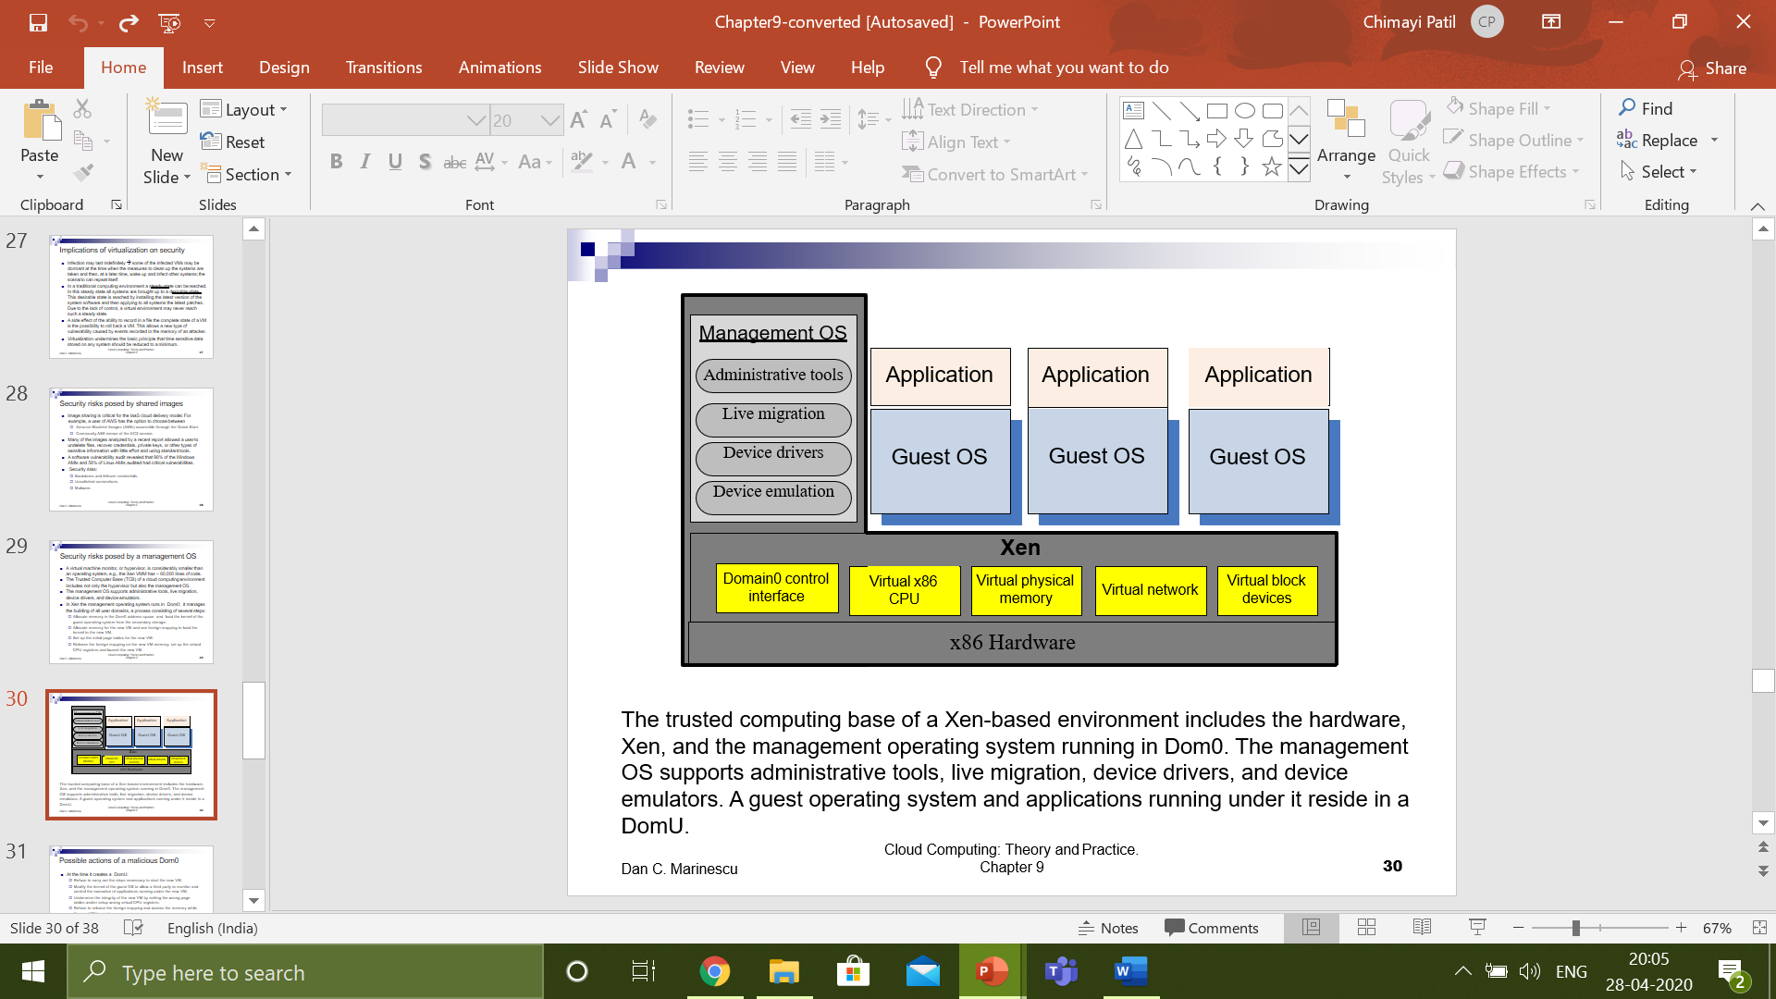
Security risks posed by a management OS
The trusted computing base of a Xen-based environment includes the hardware, Xen, and the management operating system running in Dom0. The management OS supports administrative tools, live migration, device drivers, and device emulators. A guest operating system and applications running under it reside in a DomU.
School of Computer Science and Engineering

Slide 24
Possible actions of a malicious Dom0
At the time it creates a DomU:
  Refuse to carry out the steps necessary to start the new VM.
  Modify the kernel of the guest OS to allow a third party to monitor and control the execution of applications running under the new VM.
  Undermine the integrity of the new VM by setting the wrong page tables and/or setup wrong virtual CPU registers.
  Refuse to release the foreign mapping and access the memory while the new VM is running.
At run time:
  Dom0 exposes a set of abstract devices to the guest operating systems using split drivers with the frontend of in a DomU and the backend in Dom0.
  We have to ensure that run time communication through Dom0 is encrypted.
  Transport Layer Security (TLS) does not guarantee that Dom0 cannot extract cryptographic keys from the memory of the OS and applications running in DomU.
School of Computer Science and Engineering

Slide 25
A major weakness of Xen
The entire state of the system is maintained by XenStore.
A malicious VM can deny to other VMs access to XenStore.
It can also gain access to the memory of a DomU.
School of Computer Science and Engineering

Slide 26
How to deal with run-time vulnerability of Dom0
Dom0 should be prohibited from using foreign mapping for sharing memory with a DomU unless a DomU initiates the procedure in response to a hypercall from Dom0.
When this happens, Dom0 should be provided with an encrypted copy of the memory pages and of the virtual CPU registers. The entire process should be closely monitored by the hypervisor, which, after the access, should check the integrity of the affected DomU.
A virtualization architecture that guarantees confidentiality, integrity, and availability for the TCB of a Xen-based system.
A secure environment when Dom0 cannot be trusted can only be ensured if the guest application is able to store, communicate, and process data safely.
The guest software should have access to secure secondary storage on a remote storage server for keeping sensitive data and network interfaces to communicate with the user. We also need a secure run-time system.
School of Computer Science and Engineering

Slide 27
How to deal with run-time vulnerability of Dom0
To implement a secure run-time system, we have to intercept and control the hypercalls used for communication between a Dom0 that cannot be trusted and a DomU we want to protect.
  New hypercalls are necessary to protect:
  The privacy and integrity of the virtual CPU of a VM.
  The privacy and integrity of the VM virtual memory.
  The freshness of the virtual CPU and the memory of the VM.
School of Computer Science and Engineering

Slide 28
Xoar - breaking the monolithic design of TCB
Xoar is a version of Xen designed to boost system security; based on micro-kernel design principles. The design goals are:
  Maintain the functionality provided by Xen.
  Ensure transparency with existing management and VM interfaces.
  Tight control of privileges, each component should only have the privileges required by its function.
  Minimize the interfaces of all components to reduce the possibility that a component can be used by an attacker.
  Eliminate sharing. Make sharing explicit whenever it cannot be eliminated to allow meaningful logging and auditing.
  Reduce the opportunity of an attack targeting a system component by limiting the time window when the component runs.
The security model of Xoar assumes that threats come from:
  A guest VM attempting to violate data integrity or confidentiality of another guest VM on the same platform, or to exploit the code of the guest.
  Bugs in the initialization code of the management virtual machine
School of Computer Science and Engineering

Slide 29
Xoar system components
Permanent components. XenStore-State maintains all information regarding the state of the system.
Components used to boot the system; they self-destruct before any user VM is started. They discover the hardware configuration of the server including the PCI drivers and then boot the system:
  PCIBack - virtualizes access to PCI bus configuration.
  Bootstrapper - coordinates booting of the system.
Components restarted on each request:
  XenStore-Logic.
  Toolstack - handles VM management requests, e.g., it requests the Builder to create a new guest VM in response to a user request.
  Builder - initiates user VMs.
Components restarted on a timer; the two components export physical storage device drivers and the physical network driver to a guest VM.
  Blk-Back - exports physical storage device drivers using udev rules.
  NetBack - exports the physical network driver
School of Computer Science and Engineering

Slide 30
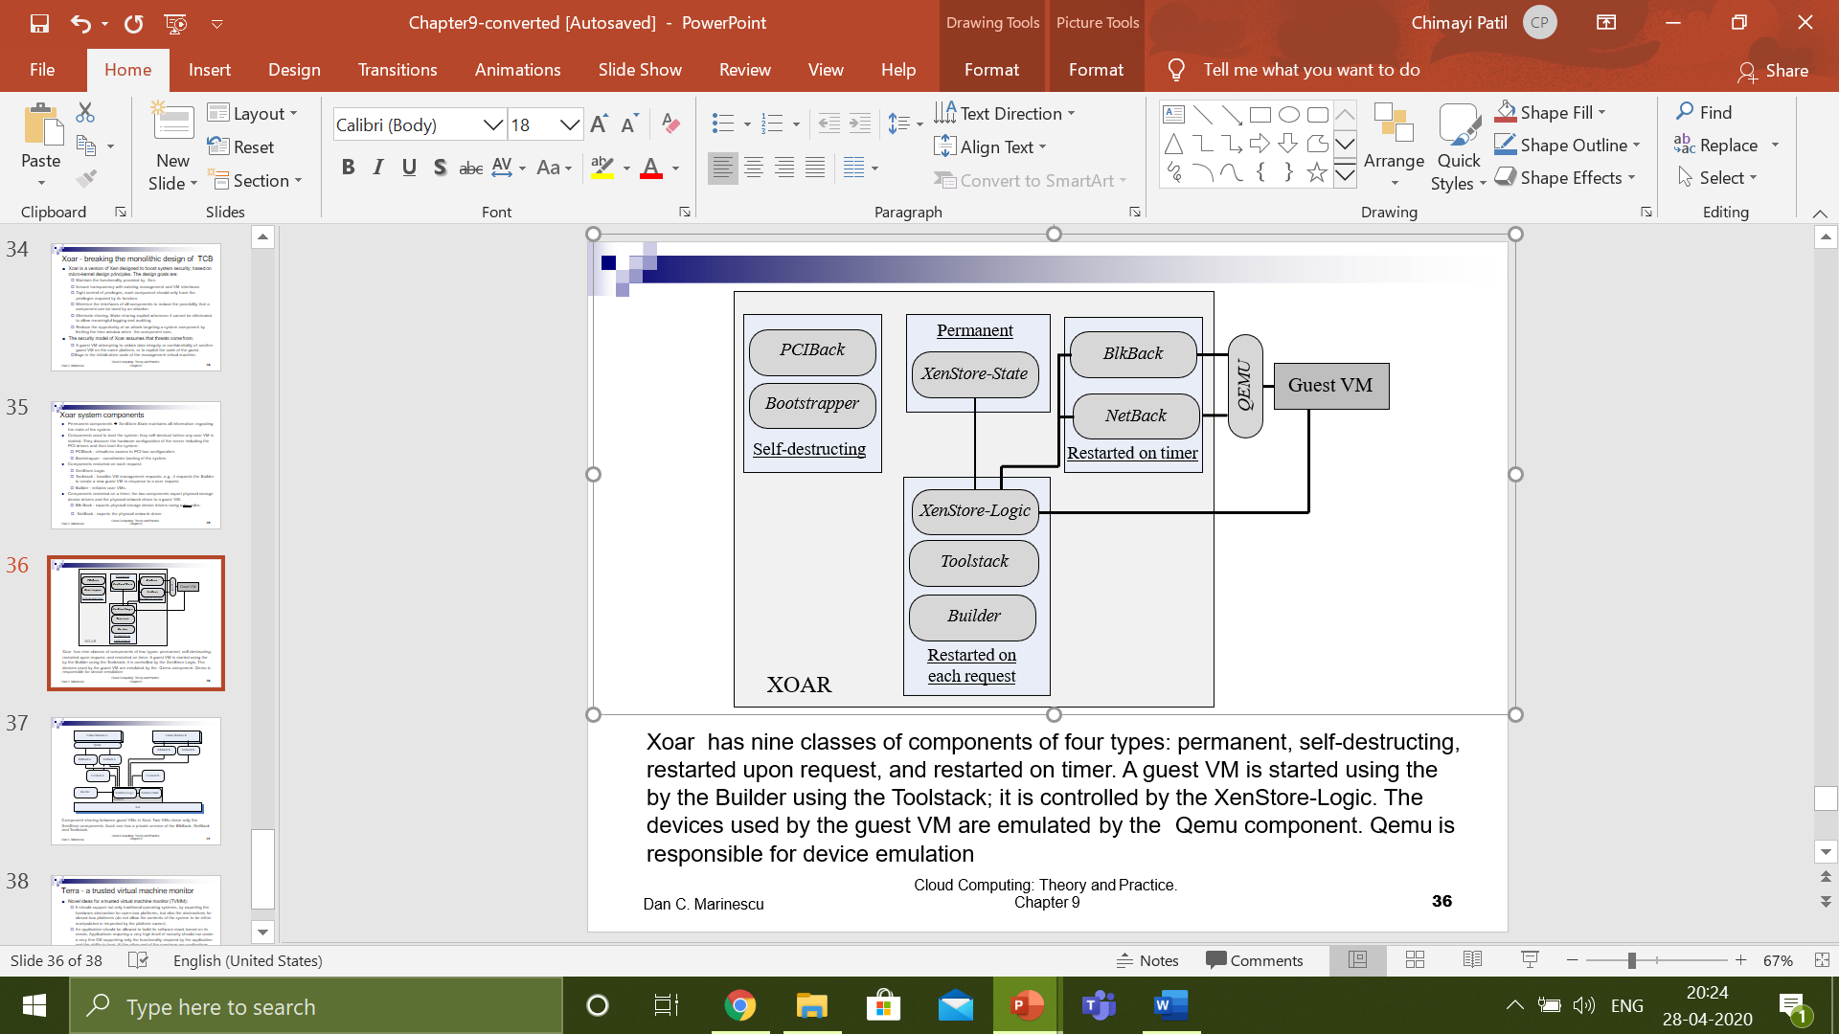
Xoar system components
Xoar has nine classes of components of four types: permanent, self-destructing, restarted upon request, and restarted on timer. A guest VM is started using the by the Builder using the Toolstack; it is controlled by the XenStore-Logic. The devices used by the guest VM are emulated by the Qemu component. Qemu is responsible for device emulation.
School of Computer Science and Engineering

Slide 31
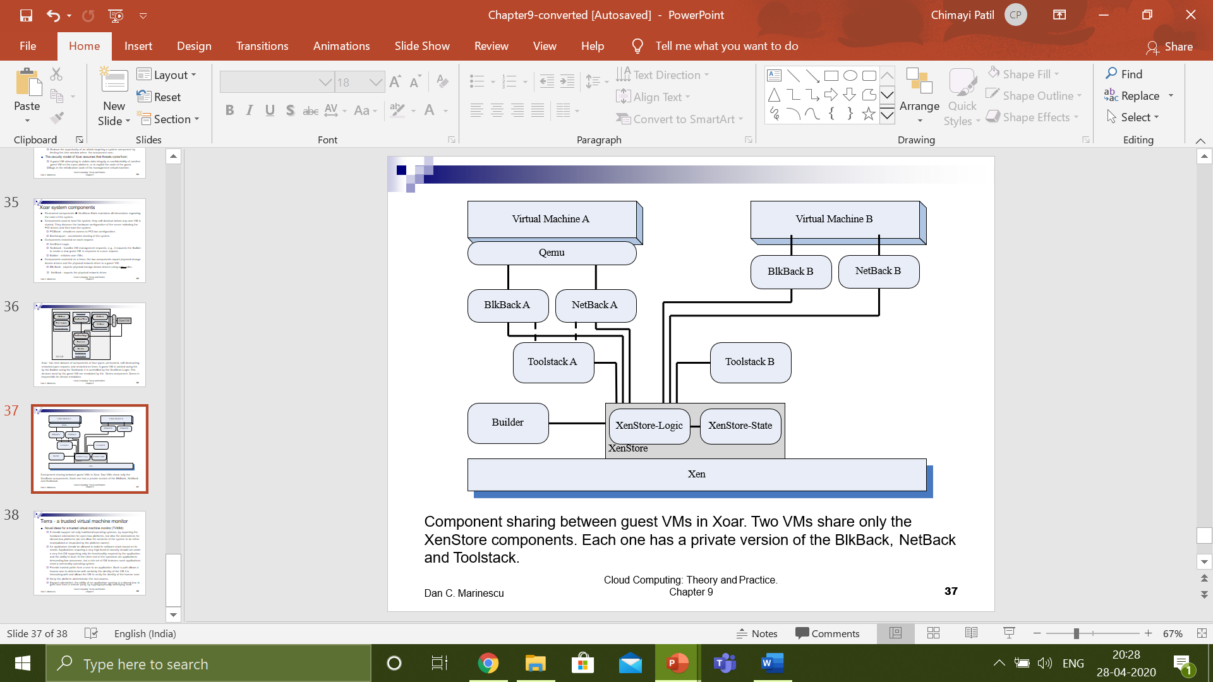
Xoar system components
Component sharing between guest VMs in Xoar. Two VMs share only the XenStore components. Each one has a private version of the BlkBack, NetBack and Toolstack.
School of Computer Science and Engineering

Slide 32
Terra - a trusted virtual machine monitor
Novel ideas for a trusted virtual machine monitor (TVMM):
  It should support not only traditional operating systems, by exporting the hardware abstraction for open-box platforms, but also the abstractions for closed-box platforms.
  An application should be allowed to build its software stack based on its needs.
  Applications requiring a very high level of security should run under a very thin OS supporting only the functionality required by the application and the ability to boot.
  At the other end of the spectrum are applications demanding low assurance, but a rich set of OS features; such applications need a commodity operating system.
  Provide trusted paths from a user to an application. Such a path allows a human user to determine with certainty the identity of the VM it is interacting with and allows the VM to verify the identity of the human user.
  Deny the platform administrator the root access.
  Support attestation, the ability of an application running in a closed-box to gain trust from a remote party, by cryptographically identifying itself.
School of Computer Science and Engineering

Slide 33
Thank you
School of Computer Science and Engineering

